Slide 1
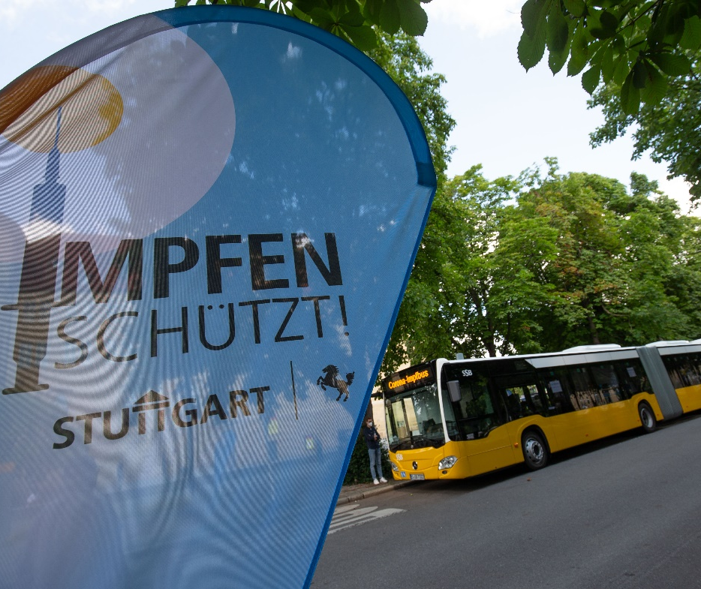
COVID-19-Vaccinations without appointments!
Mobile vaccination center will come to Hohenheim
Date: Thursday November, 11 2021
Time: 7:30 am – 14:30 (2:30 pm)
Location: Heinrich-Pabst-Straße, 70599 Stuttgart
Vaccines offered: BioNTech and Johnson & Johnson
Please bring: ID document, yellow International Certificates of Vaccinations booklet, Health Insurance Card
Bildquelle: Piechowski / Landeshauptstadt Stuttgart

